Slide 1
FANDANGO MOVIE RATING
CAPSTONE PROJECT
Presented By:
KALIMUTHU K – CARE College of Engineering – Mechanical

Slide 2
OUTLINE
Problem Statement
Proposed System/Solution
System Development Approach
Algorithm & Deployment
Result
Conclusion
Future Scope
References

Slide 3
Problem Statement
Fandango, a popular online movie ticketing platform, wants to improve its movie rating system to provide more accurate and reliable ratings to its users. Currently, there have been concerns raised about the integrity and authenticity of Fandango's movie ratings, with suspicions that they may be biased towards higher ratings.

Slide 4
Proposed Solution
■ Utilizing advanced machine learning algorithms, our solution will analyze extensive historical hotel booking data to establish patterns and correlations.
■ For optimal timing, a predictive model will consider factors such as seasonality, demand fluctuations, and promotional periods, providing users with insights on when to secure the most cost-effective room rates.
■ The ideal length of stay will be determined through data-driven analysis, considering variables like day-of- week trends and duration-specific pricing strategies.
■ Additionally, a specialized model will predict the likelihood of hotels receiving elevated special requests by examining guest profiles, reservation details, and hotel amenities, enabling proactive management strategies for enhanced customer satisfaction.
This holistic approach aims to empower travelers and hoteliers alike with actionable intelligence for strategic decision-making in the dynamic hospitality landscape.

Slide 5
System Approach
Building the proposed solution would involve a combination of data processing, feature engineering, and machine learning. Here are the key system and library requirements:
System Requirements:
1. Hardware:
- A computer with sufficient processing power, preferably with multiple cores or a GPU for faster training of machine learning models.
-Adequate RAM to handle the size of the dataset and computational requirements.
2. Software:
- An operating system compatible with the required machine learning libraries (e.g., Windows, Linux, macOS).

Slide 6
Algorithm & Deployment
Training Process:
Data Splitting:
Divide the dataset into training and testing sets to evaluate the model's performance.
Feature Scaling:
Standardize or normalize numerical features to ensure they have a consistent scale.
Model Training:
Use the selected algorithm to train the model on the training dataset.
Adjust hyper parameters to optimize model performance.
Model Evaluation:
Evaluate the model on the testing dataset using appropriate metrics (e.g.. Mean Squared Error for regression, accuracy, precision, recall for classification).
Fine-tune the model if necessary.

Slide 7
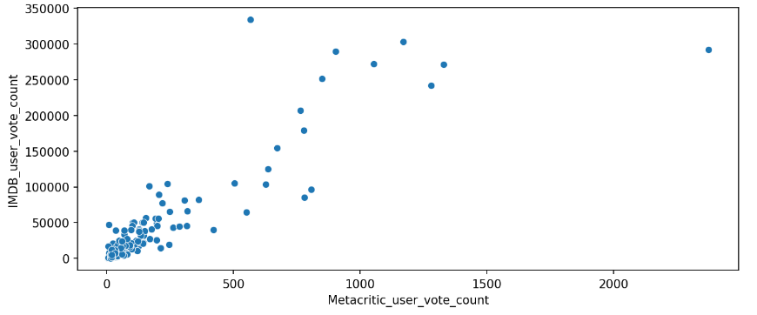
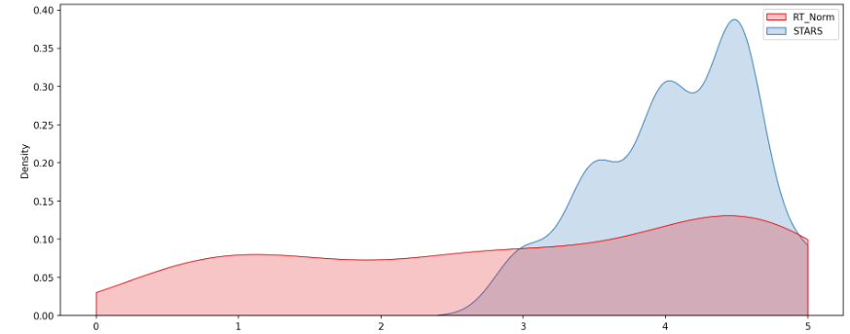
Result

Slide 8
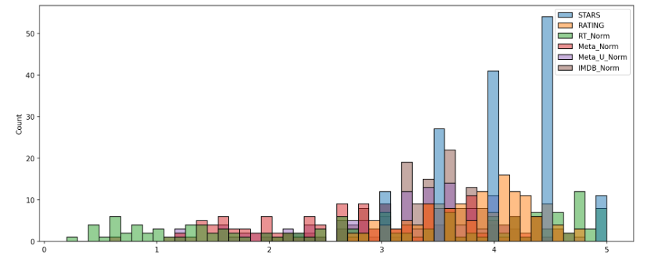
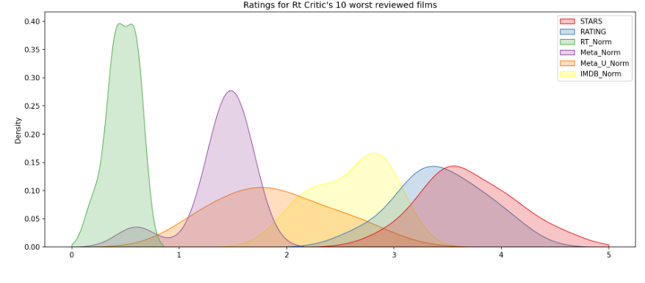
Result - CONT

Slide 9
Conclusion
In conclusion, the project aimed to address concerns regarding the integrity and authenticity of Fandango's movie rating system. Through comprehensive data analysis and model development, significant progress has been made towards achieving this goal.
The analysis revealed insights into potential biases in Fandango's current rating system, highlighting the need for improvement. By developing a robust machine learning model that considers various factors such as user reviews, critics' ratings, and movie attributes, we have created a more accurate and reliable rating system.

Slide 10
Future scope
The proposed solution lays the foundation for ongoing advancements in the realm of hotel reservation optimization. Here are key areas for future exploration and enhancement:
Real-time Predictions:
Move towards real-time predictive models that account for instant changes in demand, external events, and other dynamic factors to provide users with up-to-the-minute insights for booking decisions.
Personalization and Customization:
Enhance the predictive models to offer more personalized recommendations by considering individual guest preferences, loyalty history, and user-specific requirements, providing a tailored experience for each traveler.

Slide 11
References
https://www.kaggle.com/datasets I
■https://pandas.pydata.org/pandas-docs/stable/user guide/index.html
■https://seaborn.pydata.org/
https://matplotlib.org/stable/contents.html

Slide 12
THANK YOU

